Slide 1
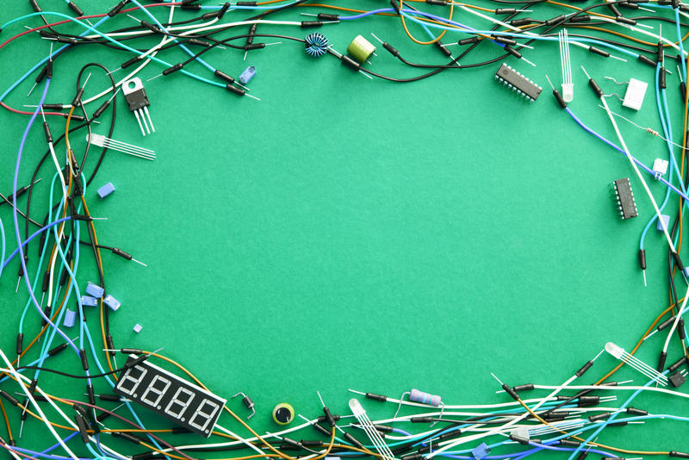

MUTE PROVISION

Slide 2
PROJECT NAME : MUTE PROVISION
TEAM MEMBERS :
AKULA PRASHANTHI SREE
GUTTA SRUTHI
N REVATHI

Slide 3



Slide 4



POWER SUPPLY
ATMEGA32
LCD 16*2
FLEX SENSOR
BUZZER

Slide 5



POWER SUPPLY
ARDUINO
UNO OR
ESP32
LCD 16*2
Flex sensors

Slide 6
MUTE PROVISION
Smart Hand Gloves help disable people to live with normal people. As dumb person cannot speak then this smart gloves helps him to convert his hand gesture into text . This also help normal person to understand what he is trying say and reply accordingly. This Smart Gloves helps the person to live independent . The main objective of the implemented project is to develop a reliable, easy to use, light weight smart hand gloves system.

Slide 7
COMPONENTS
POWER SUPPLY
FLEX SENSOR
Atmega32 or
Ardiuno un0
LCD
Bread Board

Slide 8
FLEX SENSOR
Flex Sensor plays the major role. The glove is fitted with flex sensors along the length of each finger and the thumb. The flex sensors give output in the form of voltage variation that varies with degree of bend. This flex sensor output is given to the ADC channels of microcontroller. It processes the signals and perform analog to digital signal conversion. Further the processed data is sent in a wireless manner to the receiver section. In this section the gesture is recognized and the corresponding output is displayed on LCD . This project, the barrier faced by these people in communicating with the society can be reduced to a great extent.

Slide 9
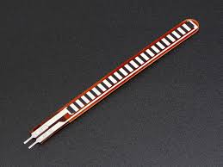

Slide 10
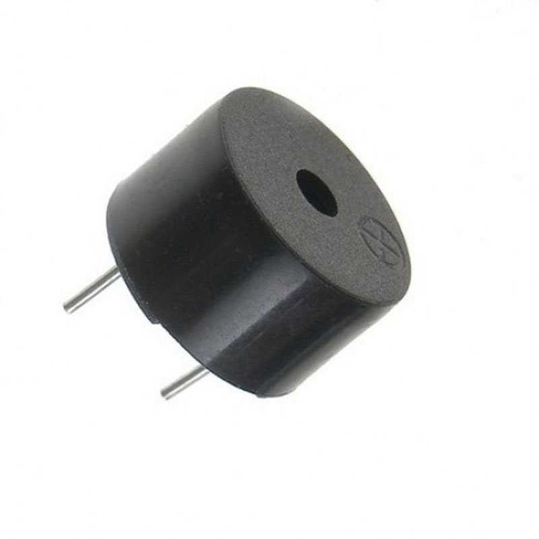
BUZZER
A buzzer or beeper is a signaling device, usually electronic, typically used in automobiles, household appliances such as a microwave oven, or game shows.

Slide 11
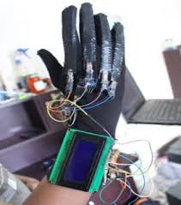

Slide 12
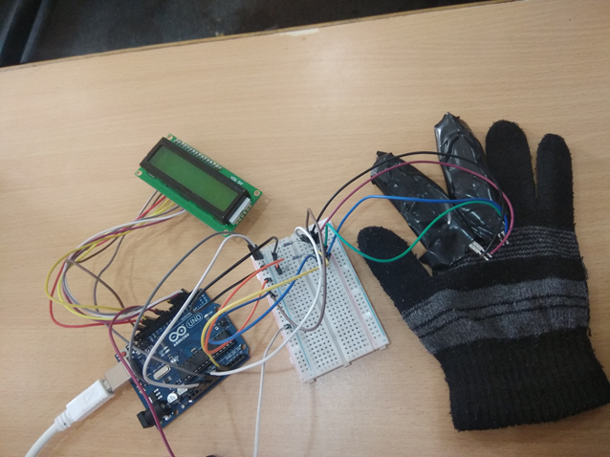

Slide 13
THANK YOU

